Slide 1
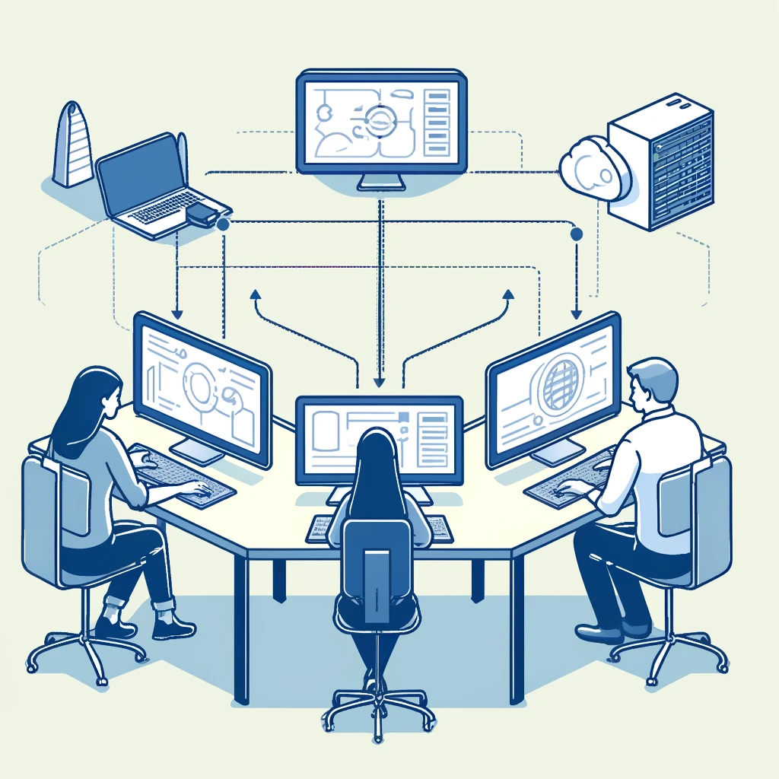
Distributed Learning for Self-Supervised Models in Large-Scale Data
CECS-574 TOPICS DISTRIBUTED COMPUTING
INSTRUCTOR: PROF. POORIA YAGHINI

Slide 2

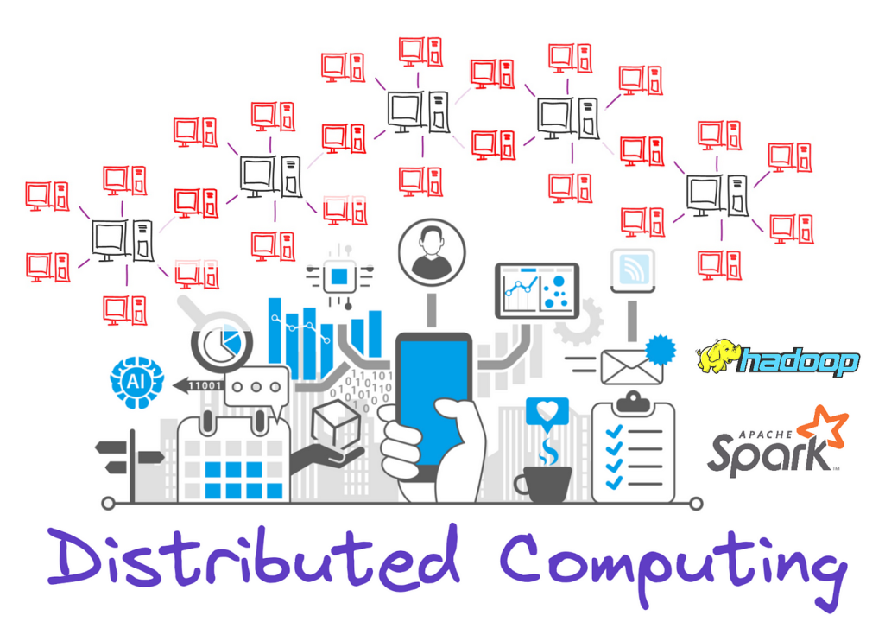
Team TriML Link
Sreelekha Chowdary Maganti-031353879
Goutham Pulivarthi-031821489
Anjali Yadav Podila-032168134

Slide 3
Introduction to Self-Supervised Learning (SSL)
Self-Supervised Learning (SSL) is an innovative approach in machine learning that utilizes unlabelled data to learn useful representations without extensive human annotation. By employing pretext tasks, models can extract meaningful features from unlabelled data, enabling them to learn effectively. This method is particularly beneficial for transfer learning, allowing pre-trained models to be fine-tuned on smaller labelled datasets, thereby improving efficiency and performance. SSL finds applications across various fields, including Natural Language Processing, Computer Vision, and Medical Imaging. Its advantages include reduced reliance on labelled data, faster training times, and enhanced model generalization. However, challenges such as the need for accuracy and the careful selection of pretext tasks remain. Overall, SSL is transforming model development and represents a vital area of research in machine learning.

Slide 4
The Value of Self-Supervised Learning (SSL) for Large-Scale Datasets
Cost-Effective Labeling: Reduces the need for manual annotation by utilizing vast amounts of unlabelled data.
Enhanced Generalization: Trains models on diverse data, improving performance on unseen datasets.
Data Efficiency: Extracts meaningful features from large datasets, even with limited labeled examples.
Scalability: Adapts to growing unlabelled data without requiring additional labeled instances.
Improved Performance: Outperforms models trained solely on labeled data, especially with limited samples.
Cross-Domain Flexibility: Applicable across various domains (image, text, audio), enabling a unified training approach.

Slide 5
Popular Approaches in Self-Supervised Learning
1. SimCLR (A Contrastive Learning Approach)
Learns representations by maximizing agreement between differently augmented views of the same image.
Involves data augmentation, a contrastive loss function, and a deep neural network encoder.
Effective in computer vision tasks by creating strong visual representations.
2. BEiT (Bidirectional Encoder Representation from Image Transformers)
Utilizes Vision Transformers (ViTs) to predict visual tokens masked within an image.
Learns robust feature representations by training the model to understand the contextual structure of images.
Demonstrates state-of-the-art results in image classification and segmentation tasks.
Roles of SSL in Vision Tasks:
SimCLR: Excels at building image representations for downstream classification tasks.
BEiT: Enhances performance in complex vision tasks, such as object detection and segmentation, by leveraging transformer-based architectures.

Slide 6

Distributed Learning Overview
Distributed Learning
Distributed Learning is a machine learning approach where training tasks are divided across multiple devices (GPUs, TPUs, or CPUs) to handle large-scale datasets more efficiently.
Essential for training complex models on large datasets, which can be computationally prohibitive on a single machine.
Why is Distributed Learning Necessary for Large Datasets?
Large datasets require substantial memory and computational power.
Distributed learning enables the processing of vast data by dividing tasks, making training faster and more feasible for deep learning models.

Slide 7
Key Concepts in Distributed Learning
Data Parallelism
Approach: Divides the dataset into smaller batches, processed independently by different worker nodes.
Process:
Each worker maintains a model copy.
Workers update parameters based on local batches.
Model parameters are synchronized.
Best for: Large datasets and models that can be easily parallelized.
Model Parallelism
Approach: Divides the model into smaller parts, assigned to different worker nodes.
Process: Workers process different model layers in parallel.
Best for: Extremely large models that don't fit on a single device.

Slide 8
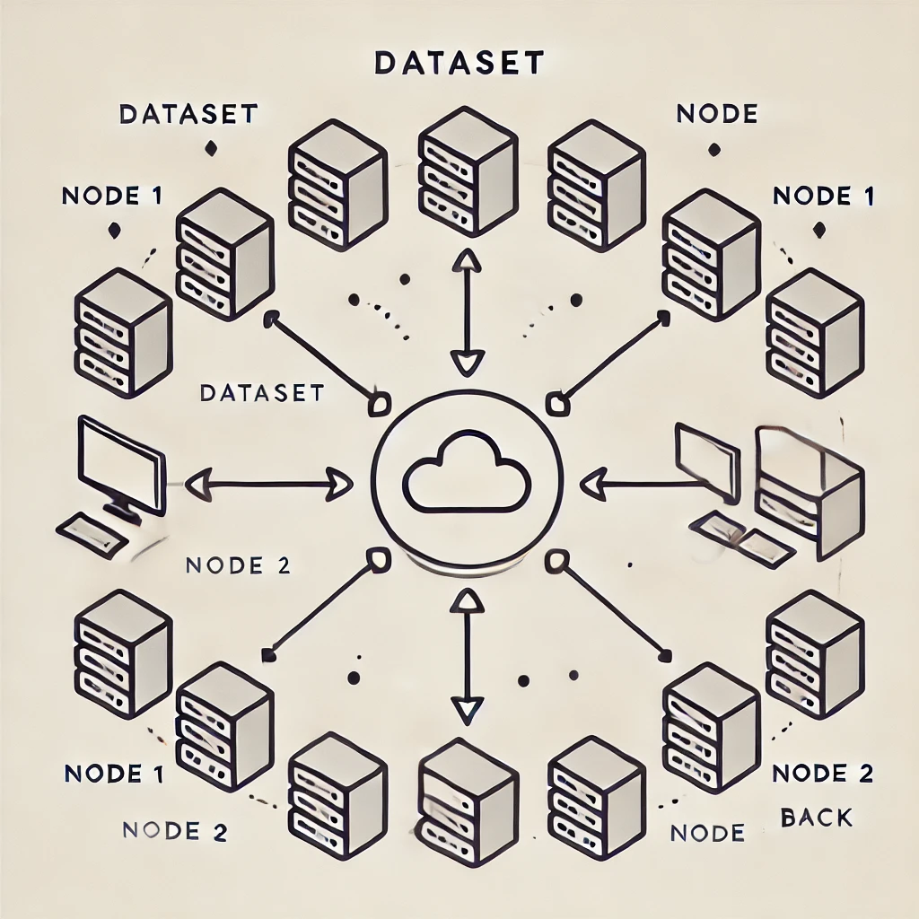
Why Distributed Training in Self-Supervised Models?
Handling Large-Scale Datasets Efficiently
SSL leverages unlabeled data, enabling models to learn from vast data sources.
With Distributed Learning, multiple GPUs process data in parallel, significantly increasing speed.
Key Benefits of Distributed Training in SSL:
Reduced Training Time
Speeds up processing of large datasets by distributing the load across GPUs or machines.
Optimized Resource Utilization
Balances computational load, utilizing hardware resources to their full potential.
Scalability for Larger Models
Supports scaling to larger, more complex models, handling massive data without performance bottlenecks.

Slide 9
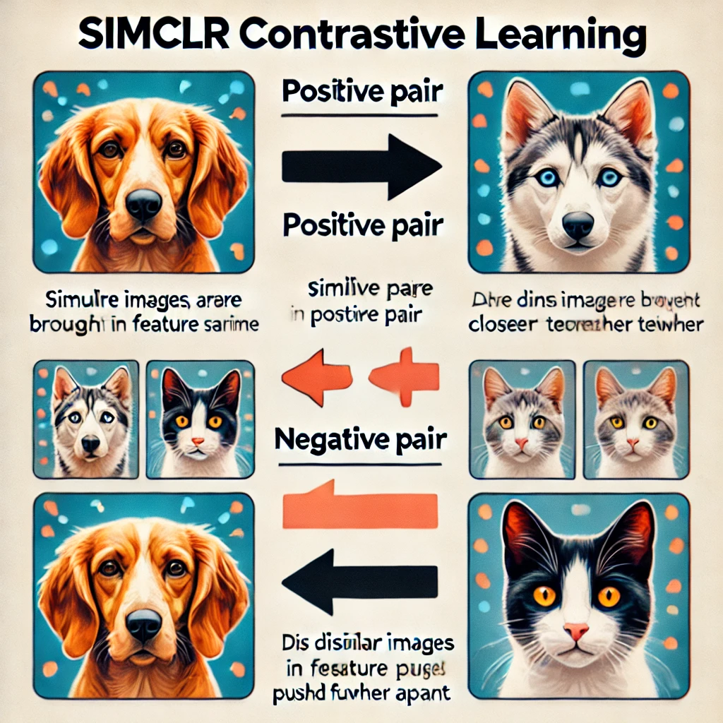
Self-Supervised Models in Distributed Learning with SimCLR
SimCLR (Simple Framework for Contrastive Learning of Visual Representations):
A contrastive learning approach that uses data augmentation to create positive and negative pairs.
Encourages the model to maximize similarity between augmented views of the same image while distinguishing from others.
Well-suited for unsupervised image classification and general feature extraction.

Slide 10
Model Architecture
SimCLR Model Architecture with ResNet Backbone
1. SimCLR Model Overview:
Self-Supervised Learning Objective:
SimCLR uses contrastive learning to teach models representations by distinguishing between similar and dissimilar data without labeled inputs.
2. Backbone Network – ResNet:
ResNet Variants:
ResNet18 and ResNet50 are common backbones, chosen for their efficient, hierarchical feature extraction.
ResNet Layers capture complex visual patterns, suitable for large-scale image data.

Slide 11
Distributed Data Parallelism (DDP) in PyTorch
Content:
1. What is Distributed Data Parallelism (DDP)?
Purpose: Optimizes model training across multiple GPUs by dividing the workload.
Efficiency Gain: Reduces the time required to process large datasets, making multi-GPU training feasible and faster.
2. How DDP Works in PyTorch:
Parallel Execution: Each GPU runs a model instance, processing a unique data batch in parallel with others.
Synchronization: After each forward and backward pass, gradients are averaged across GPUs, ensuring consistent updates.

Slide 12
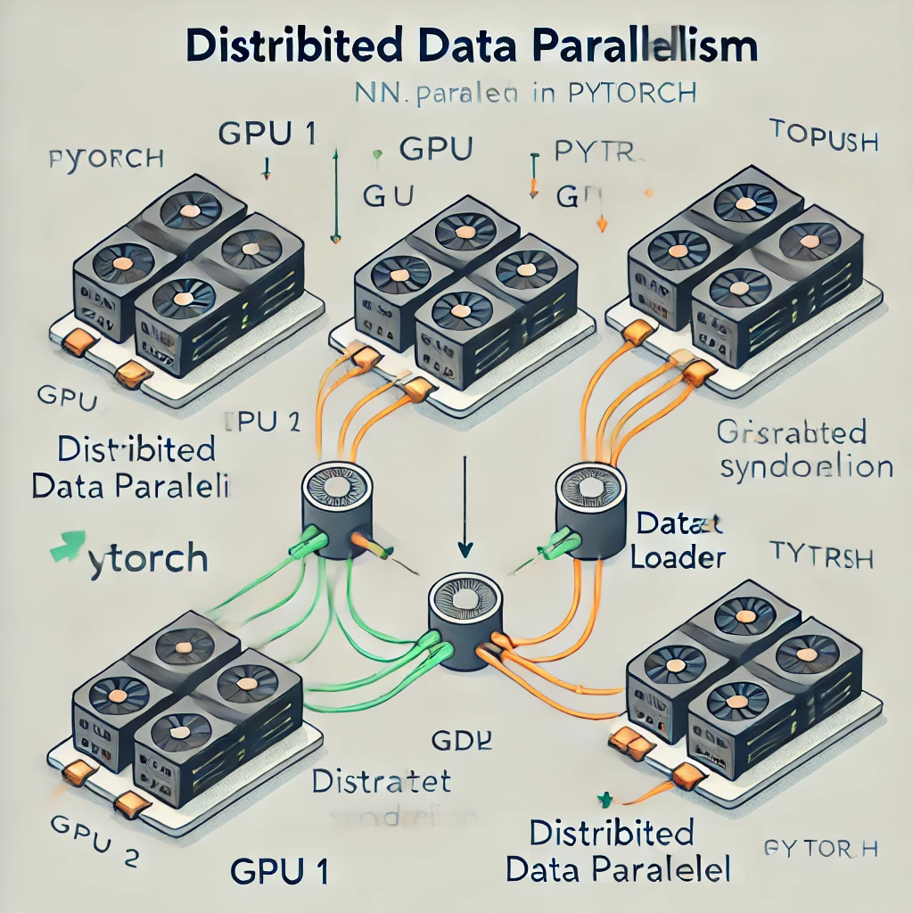
DDP Implementation in SimCLR
Implementing DDP with torch.nn.parallel.DistributedDataParallel
1. Model Wrapping for Efficient Parallelization
DDP Wrapping: Each model instance is wrapped with torch.nn.parallel.DistributedDataParallel to handle parallelism automatically.
Resource Optimization: Ensures minimal GPU memory overhead, allowing seamless scaling for larger models.
2. Advantages of Using DDP in SimCLR:
Efficient Gradient Synchronization: Prevents bottlenecks during training by synchronizing gradients only after backpropagation.
Scalable to Multiple GPUs: Supports seamless scalability, making it ideal for handling large datasets.

Slide 13
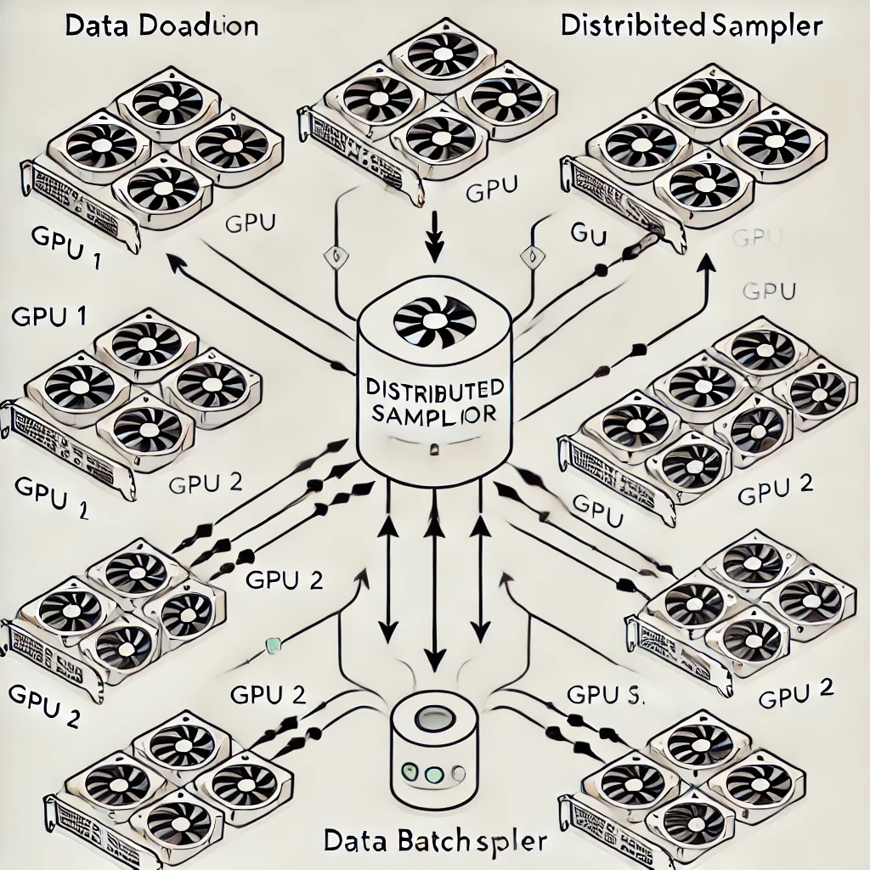
Data Distribution Using DistributedSampler
Purpose of DistributedSampler in Multi-GPU Training:
Data Splitting: Ensures each GPU receives a unique subset of data, allowing parallel processing without data overlap.
Efficient Distribution: Partitions data batches evenly, optimizing the workload across GPUs.
How Distributed Sampler Maintains Consistency:
Synchronization Across Nodes: During each epoch, DistributedSampler re-shuffles data to maintain variety while preserving data order across GPUs.
Avoids Redundancy: Guarantees that each data sample is only processed once per epoch, preventing duplication across nodes.

Slide 14
Data Augmentation Techniques
1. Importance of Data Augmentation in SimCLR:
Data augmentation creates diverse views of the same image, essential for contrastive learning to learn invariant features.
2. Augmentation Techniques Used:
Random Cropping:
Crops a random portion of the image, focusing on different parts of the object each time.
Color Jittering:
Randomly adjusts brightness, contrast, and saturation, creating a varied color distribution.
Random Horizontal Flip:
Flips the image horizontally with a certain probability, ensuring the model learns from mirrored views.

Slide 15
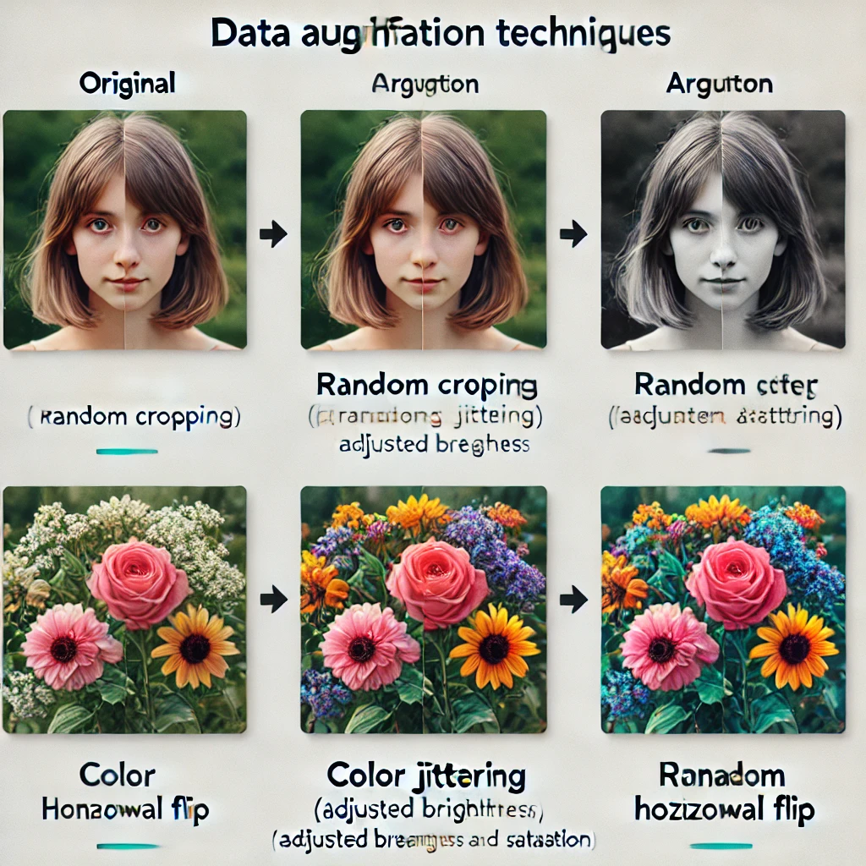
Visual Representation of Data Augmentation

Slide 16
Contrastive Loss - NT-Xent
What is NT-Xent Loss?
Definition:
NT-Xent stands for Normalized Temperature-Scaled Cross-Entropy Loss.
Purpose in SimCLR:
Used to train the model to pull similar images closer together (positive pairs) and push dissimilar images apart (negative pairs).
Key Features:
Normalization: Ensures stability during training by making embeddings scale-invariant.
Temperature Scaling: Controls the sharpness of the similarity distribution, aiding in learning from difficult negative examples.
How NT-Xent Loss Works:
Positive Pairs:
Consist of two augmented views of the same image.
NT-Xent Loss minimizes the distance between these pairs in the representation space.
Negative Pairs:
Consist of views from different images.
Loss maximizes the distance between these pairs to improve model discriminability.
3. Importance in Contrastive Learning:
Enhanced Feature Distinction:
Teaches the model to identify unique features, creating robust representations.
Improved Similarity for Positive Pairs:
Ensures the model consistently recognizes different augmented views of the same image as similar.

Slide 17
Hyperparameters and Training Monitoring
Tuning & Monitoring for Optimal Performance
Key Hyperparameters for SimCLR Training:
Batch Size:
Determines the number of samples per gradient update.
Learning Rate:
Controls the step size for weight updates; a critical factor in model convergence speed and stability.
Optimizer Configuration:
Common choices include Adam or SGD, with settings like momentum and weight decay to improve convergence.
Monitoring Metrics for Performance Tracking:
Loss:
Measures how well the model is learning by comparing predictions to targets; a decrease over time indicates learning progress.
Accuracy (or Similarity Score):
Tracks how well the model distinguishes positive pairs from negative pairs, an indicator of effective contrastive learning.
Learning Rate Schedule:
Adjusts learning rate dynamically during training to optimize convergence and avoid overshooting.

Slide 18
Conclusion
In Conclusion, implementing SimCLR with Distributed Data Parallelism (DDP) enables efficient self-supervised learning at scale by significantly reducing training time and optimizing GPU resource usage. This approach allows for effective learning from vast unlabeled datasets through contrastive learning, resulting in robust feature representations without the need for labeled data. Future enhancements could include exploring advanced model architectures, automating hyperparameter tuning, and adapting SimCLR for domain-specific applications such as healthcare and autonomous systems. Overall, this framework accelerates the development of high-performance models and broadens the scope of self-supervised learning in real-world scenarios.

Slide 19
Future Work
Enhanced Training Efficiency:
Distributed Data Parallelism (DDP) with SimCLR reduces training time, making large-scale dataset processing feasible.
Optimized Resource Utilization:
DDP and DistributedSampler allow for balanced, scalable training by effectively distributing data and computation across GPUs.
Improved Model Robustness:
Through contrastive learning and data augmentation, SimCLR learns robust, transferable representations, enhancing performance on various tasks.
Explore Advanced Architectures:
Experiment with more complex backbones, like ResNet101 or Vision Transformers, to improve feature learning.
Hyperparameter Optimization:
Use automated tuning methods (e.g., grid search or Bayesian optimization) to achieve faster, more stable convergence.
Domain-Specific Fine-Tuning:
Adapt SimCLR with DDP for specialized applications, such as medical imaging or real-time processing, to increase its practical utility.

Slide 20

Thank you

